Slide 1
Probabilistic Data Structures

Slide 2
Agenda
Problems
Membership
Cardinality
Frequency
Demo
Q&A

Slide 3
Real-world problems
When process data sets, we want do some queries:
Does an element exist ?
How many distinct elements ?
The frequency of an element ?

Slide 4
Simple approaches
Hash table/Hash Set
Database

Slide 5
Problems with large data sets
Fast response
Resource limitations
Slow query

Slide 6
Probabilistic data structures
Bloom filter
Cuckoo filter
Quotient filter
Membership
Cardinality
Frequency
Rank
Similarity
Count Min Sketch
Majority algorithm
Frequent algorithm
Q-digest
T-digest
MinHash
SimHash
HyperLogLog
Probabilistic Counting
Notes:
PDS is a common name for data structures based mostly on different hashing techniques. Unlike regular ( or deterministic) data structures, they provides approximated answers but with reliable way to estimate possible errors. Instead, they use extremely low memory, constant query time

Slide 7
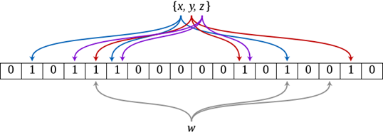
Membership – Bloom Filter
Bloom filter is a bit array initialized to 0
Add an element: use k hash functions to get k index -> set bits to 1
Query: check bits after hash
If any 0: definately not in
If all are 1, might be in

Slide 8
Membership – Bloom Filter
Use to check whether an element is a member of a set
False-positive is possible but false-negative is impossible
Only can add elements, cannot remove.
Error rate increases when added more elements.
Union and intersection with bitwise OR and AND

Slide 9


m: size of bit array
n: estimated insertions
p: false-positive probability
k: optimum number of hash functions
Hash functions should be fast, good distribution & collision resistance: Murmur hash, FNV hash series, Jenkins hashes.

Slide 10
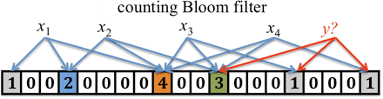
Counting Bloom Filter
Contains a bit array and an array of counters length m
Compute corresponding bit positions, then increase the associated counter with add or decrease with remove action.
Support deletion
N-times more space than classic BF
CBF cannot be expanded => the maximum keys must be determined in advance.

Slide 11
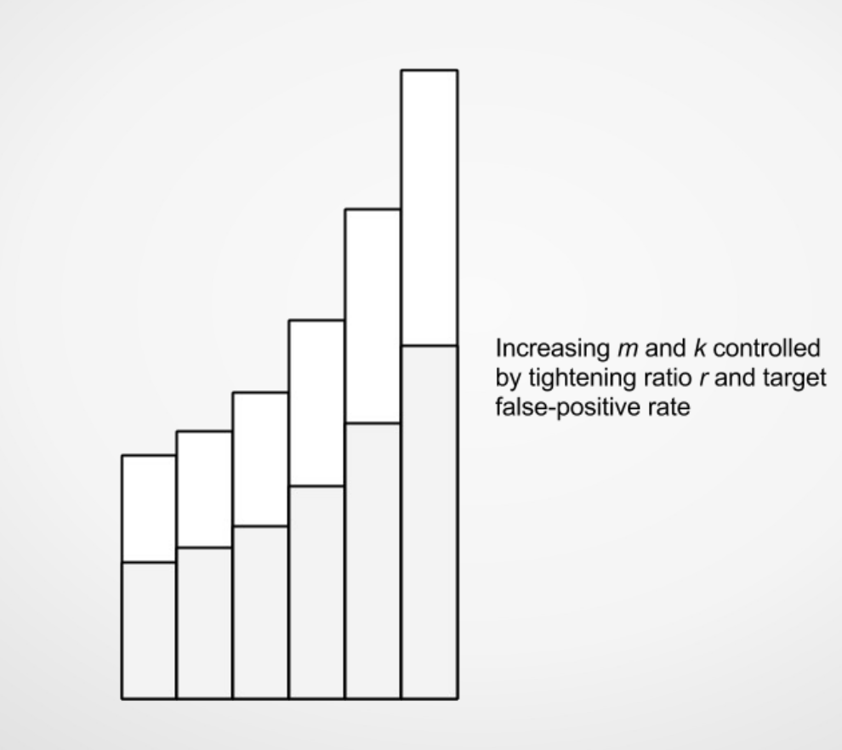
Scalable Bloom Filter
Scalable BF is an array of bloom filters.
Don’t need prior knowledge of the size.
Add new filters with tightened error probability when current filters reach a target fill ratio.
New elements are added to the last filters.

Slide 12
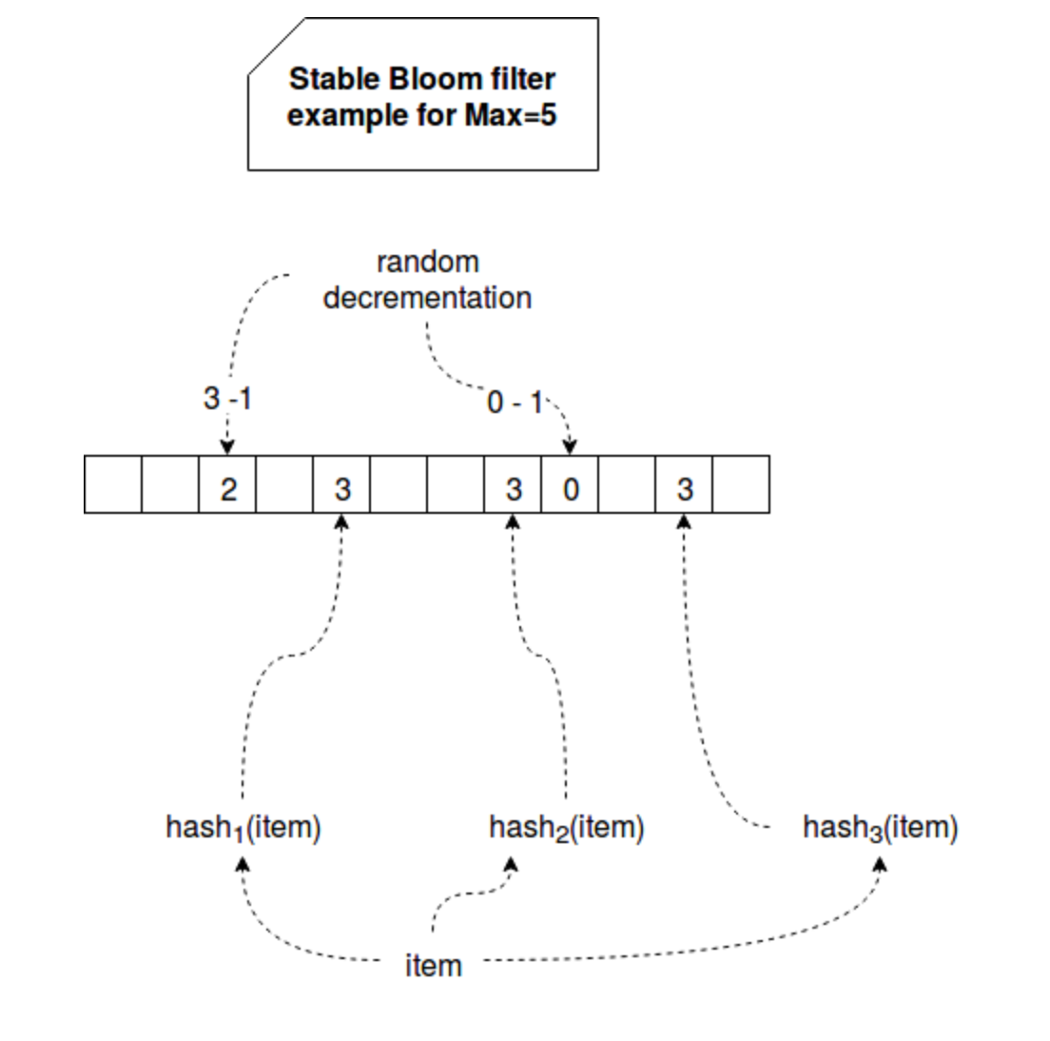
Stable Bloom Filter
Use to detect duplicates in unbounded data stream with limited space
Continuously evict stale data
Introduces false-negative, guarantee a tight upper bound of false positive.

Slide 13
Layered Bloom Filter
A layered bloom filter consists of multiple bloom filter layers
Use to track how many times an item was added to the BF
Normally return the deepest layer an item was found in.

Slide 14
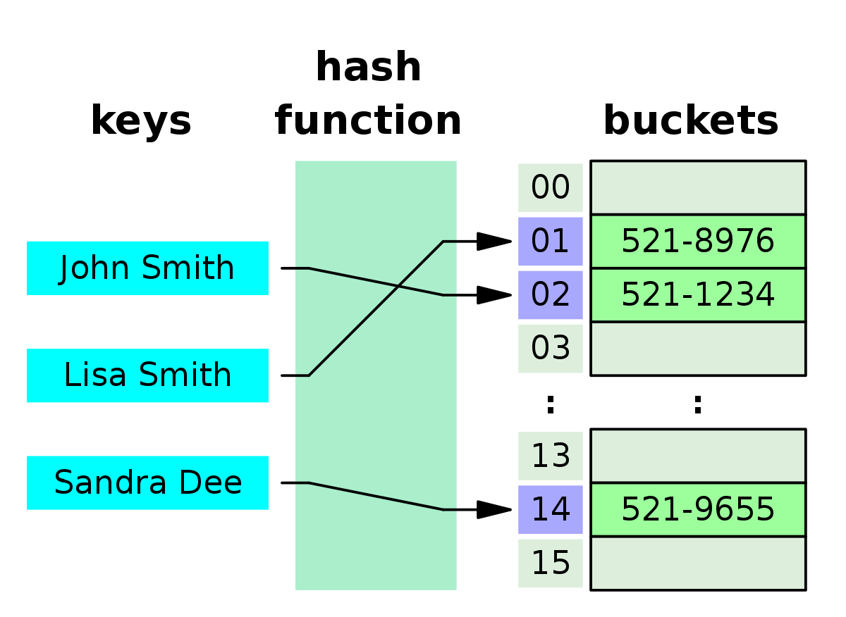
Inverse Bloom Filter
Also called “Opposite Bloom Filter”
May raise false-negative but never report a false positive
Behaves in a similar manner to a fixed size hash map but does not handle conflicts.
Can deal with unbound stream or large data sets since it limits memory usage
Use-case: same as BF but don’t want false-positive.
Notes:
Also called “Opposite Bloom Filter”, may raise false negative but never report a false positive.
IBF behaves in a similar manner to a fixed size hash map of m buckets which does not handle conflicts, but provides lock-free concurrency.
IBF can deal with unbound streams or large data sets since it limit memory usage.
Use-case: There is duplications in a stream but
at least the original must be wrote into DB (duplicates is allowed). If using the BF, may miss some record since ‘false positive’ characteristic of BF.

Slide 15
Applications
Google BigTable, Apache Hbase, Apache Cassandra use BF to reduce disk lookups for non-existent rows or columns.
Google Chrome uses Bloom Filter to check if an URL is a threat or not. If Bloom Filter says that it is a threat, then it goes to another round of testing before alerting the user.
Bitcoin is using Bloom Filter due to its efficient performance and it minimizes the risk of triggering DDoS attacks.
Zalo ads uses Bloom Filter to track user interaction with ads.

Slide 16
Other membership DS
Cuckoo filter
Roaring bitmaps
Quotient filter
. . .

Slide 17

Cardinality - HyperLogLog
LINEAR COUNTING

Slide 18
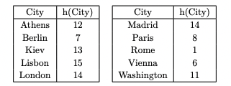


Cardinality - HyperLogLog
LINEAR COUNTING
v = (number of 0 / total) = 9/ 16 ~= 0.5625
n ~ -16 * ln 0.5625 ~ 9.26

Slide 19
Cardinality - HyperLogLog
LINEAR COUNTING
O(N) time complexity
Error rate increases when more data added
Must know data size in prior

Slide 20
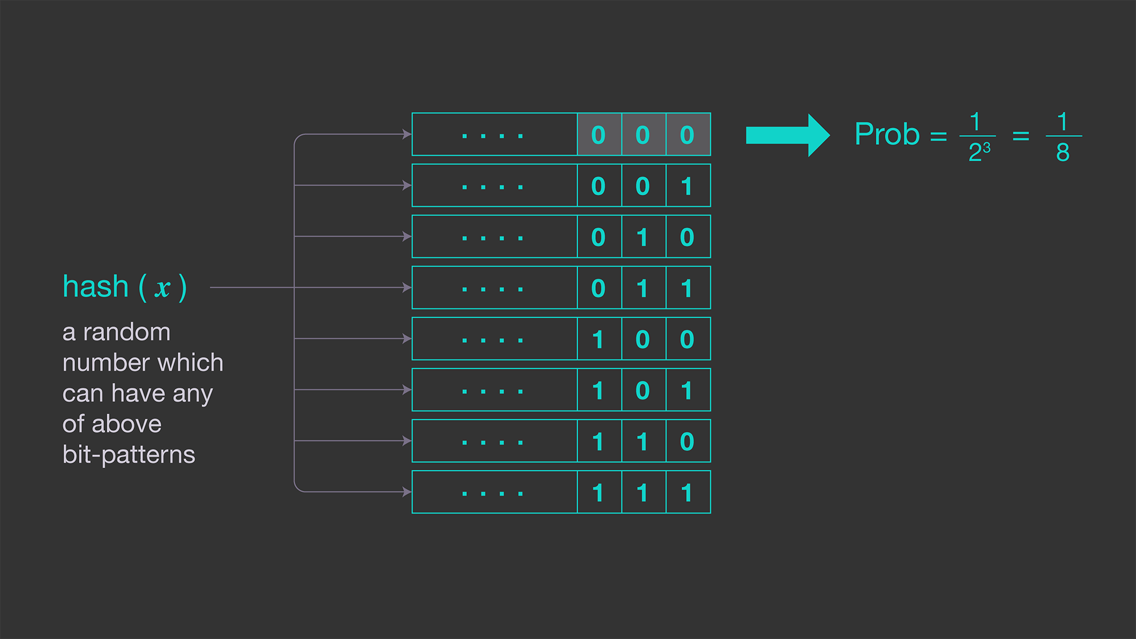
Cardinality - HyperLogLog
Probabilistic Counting
R = maximum consecutive 0 in hashes
N = 2^R
Notes:
By observed bit pattern

Slide 21
Cardinality - HyperLogLog
Probabilistic Counting
Drawbacks:
The result is only be of 2^R: {1,2,4, . . ., 1024, 2048, ..}
Might have high variability
Notes:
At best, this can give us a power of two estimate for the cardinality and nothing in between. Because of in the above formula, the resulting cardinalities can only be one of .
The estimator still has high variability. Because it’s recording the maximum , it requires only one entry whose hash value has too many consecutive zeros to produce a drastically inaccurate (overestimated) estimate of cardinality.

Slide 22
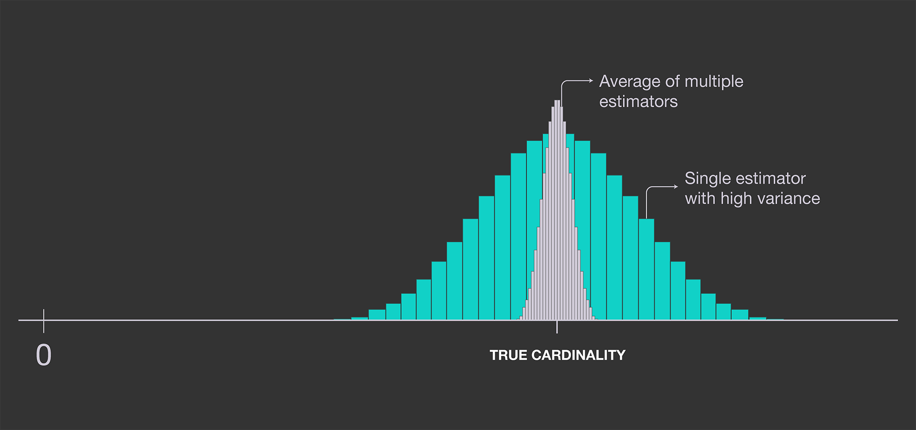
Cardinality - HyperLogLog
LogLog
Can use m hash functions then R = R1 + R2 + . . . Rn) / m
-> Computational expensive
Notes:
At best, this can give us a power of two estimate for the cardinality and nothing in between. Because of in the above formula, the resulting cardinalities can only be one of .
The estimator still has high variability. Because it’s recording the maximum , it requires only one entry whose hash value has too many consecutive zeros to produce a drastically inaccurate (overestimated) estimate of cardinality.

Slide 23
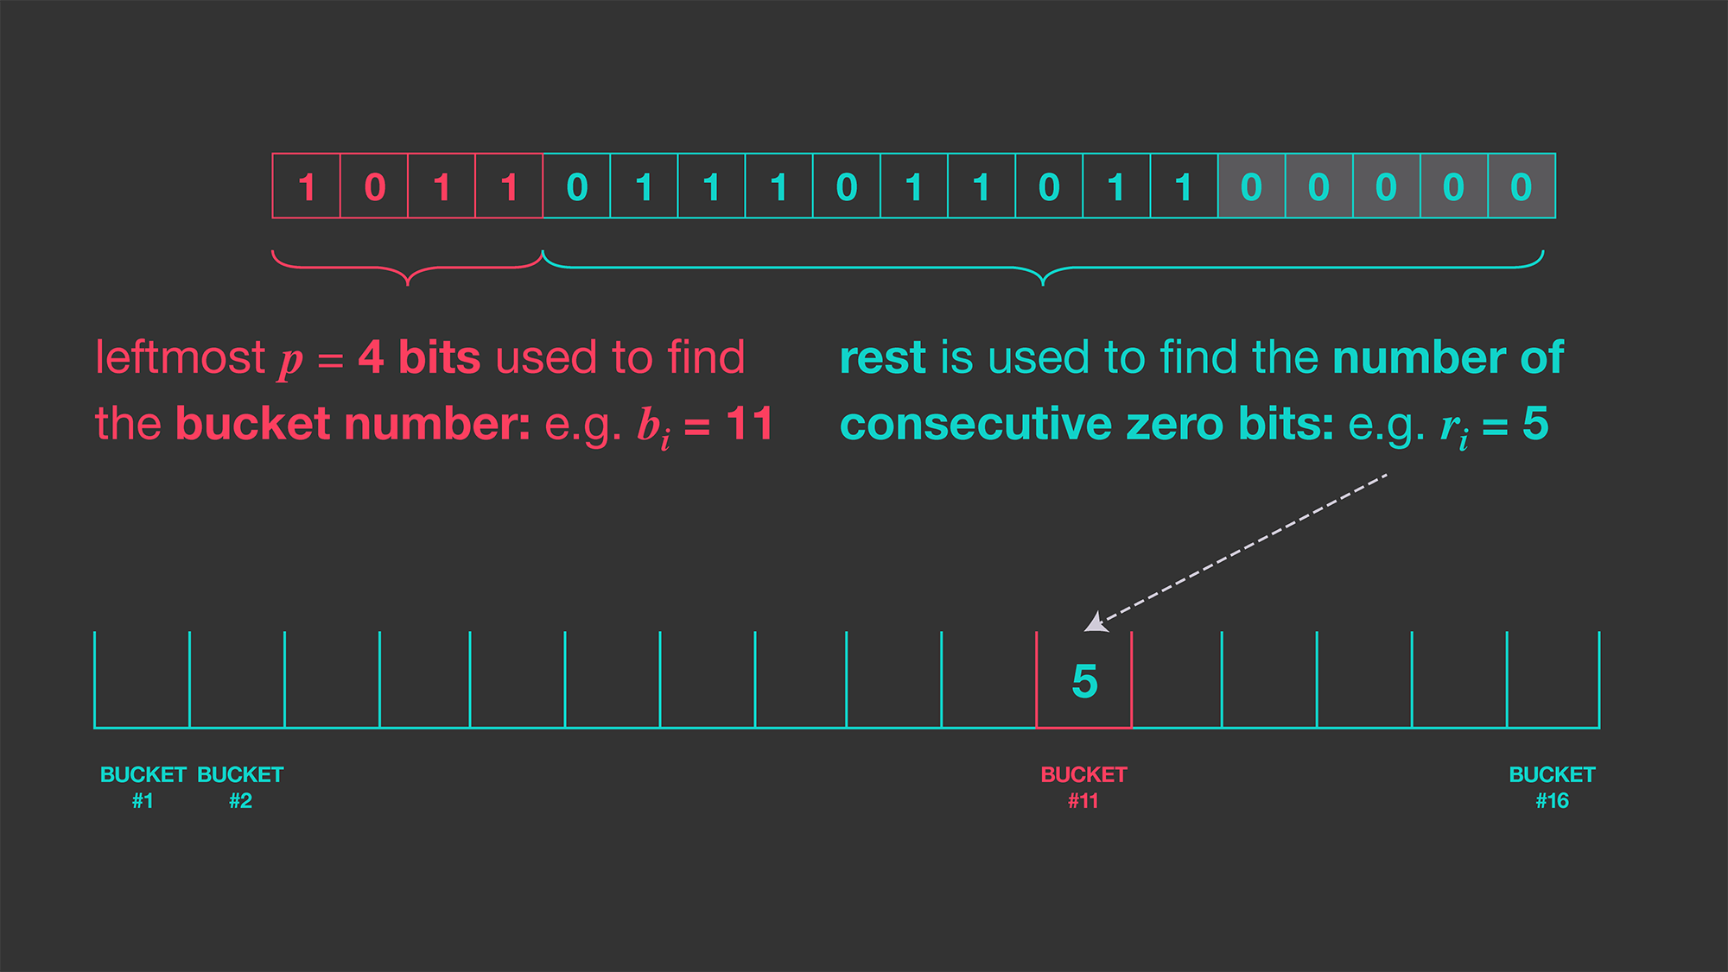
Cardinality - HyperLogLog
LogLog
Use first k bits to index bucket
The rest to compute longest 0 sequence
Constant = 0.79402
Notes:
For m buckets, this reduces the standard error of the estimator to about . Thus, with 2,048 buckets where each bucket is 5 bits (which can record a maximum of 32 consecutive 0s), we can expect an average error of about 2.8 percent; 5 bits per bucket is enough to estimate cardinalities up to per the original paper and requires only 2048 * 5 = 1.2 KB of memory. That’s pretty good for basically 1 KB of memory.

Slide 24

Cardinality - HyperLogLog
SuperLogLog
Get 70 % of the smallest elements to increase accuracy
Notes:
For m buckets, this reduces the standard error of the estimator to about . Thus, with 2,048 buckets where each bucket is 5 bits (which can record a maximum of 32 consecutive 0s), we can expect an average error of about 2.8 percent; 5 bits per bucket is enough to estimate cardinalities up to per the original paper and requires only 2048 * 5 = 1.2 KB of memory. That’s pretty good for basically 1 KB of memory.

Slide 25
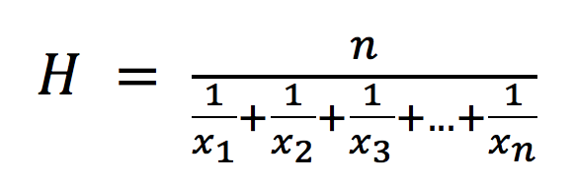
Cardinality - HyperLogLog
HyperLogLog
Use Harmonic Mean instead of Geometric Mean (LogLog)
Accuracy rate is about
Notes:
For m buckets, this reduces the standard error of the estimator to about . Thus, with 2,048 buckets where each bucket is 5 bits (which can record a maximum of 32 consecutive 0s), we can expect an average error of about 2.8 percent; 5 bits per bucket is enough to estimate cardinalities up to per the original paper and requires only 2048 * 5 = 1.2 KB of memory. That’s pretty good for basically 1 KB of memory.

Slide 26
Cardinality - HyperLogLog
HyperLogLog
With 2048 buckets, 5 bits per bucket ( 32 consecutive 0s).
Average error: 1.04/ sqrt(2048) = 2.29%
Can estimate up to: 2 ^ 27 = 134 217 728
Memory: 2048 * 5 = 1.2 KB
Notes:
For m buckets, this reduces the standard error of the estimator to about . Thus, with 2,048 buckets where each bucket is 5 bits (which can record a maximum of 32 consecutive 0s), we can expect an average error of about 2.8 percent; 5 bits per bucket is enough to estimate cardinalities up to per the original paper and requires only 2048 * 5 = 1.2 KB of memory. That’s pretty good for basically 1 KB of memory.

Slide 27
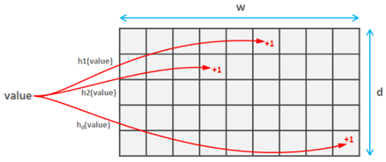
Frequency – Count Min Sketch
Similar to Bloom Filter but represents multi-set which keeps frequency distribution summary
Is a two-dimensional array ( d x w) of integer counters
Add an element: increase counter of each d rows with d independent hash functions
Estimate frequency: minimum value of the counts

Slide 28
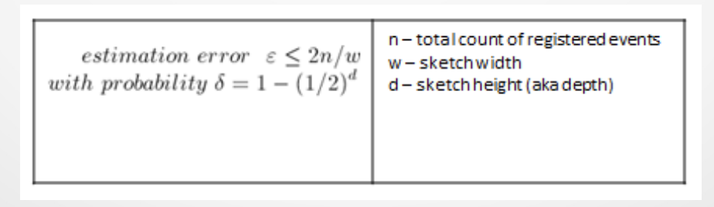
Frequency – Count Min Sketch
Chose the right value for d and w for small error and high probability

Slide 29
Demo

Slide 30
Q & A

Slide 31

Thanks!

